Slide 1
Computer Networks
L. Budi Handoko, M.Kom. (handoko@dsn.dinus.ac.id)
Dian Nuswantoro University

Slide 2
Course Content (Syllabus)
Understanding about basic concept of (computer) networks.
Understanding about network applications, utilizations and future plans and technology.
Understanding about networks benefits and liability on all aspect (social, education, economy, security, etc.).
Understanding about networks structure, achitecture, classification, devices and topology.
Understanding about networks reference or standardization, now and then.
Understanding about security, the risk and anticipation.

Slide 3

References
Andrew S. Tanenbaum, Computer Networks, 4th Edition, Prentice Hall, 2003
S.S. Shinde, Computer Network, New Age, 2009
Libor Dotálek and Alena Kabelová, Understanding TCP/IP, Packt, 2006

Slide 4

Grading Guidelines
Middle Exam (20%)
Final Exam (30%)
Certification (20%)
Assignments (30%), consisting :
Individual Assignment
Group Assignment
Attendance
Project or Challange (If Any...)

Slide 5

Any Question ?
Anything to discuss ?

Slide 6
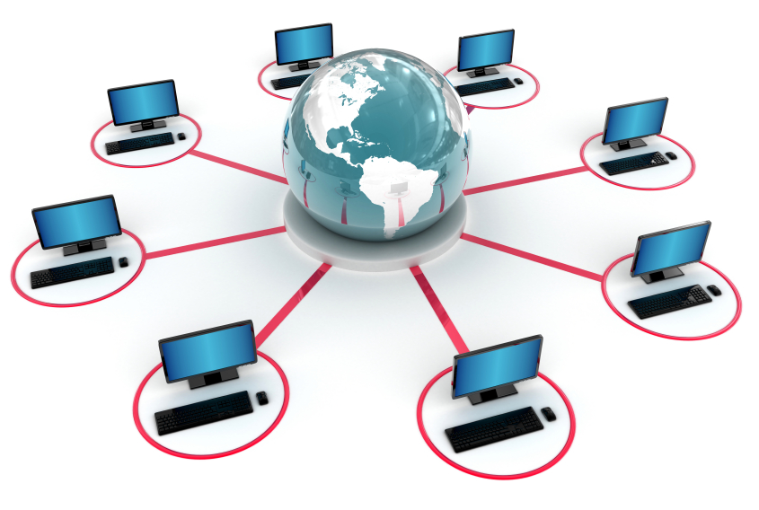
Introduction to Computer Networks (Basic Concept of Computer Networks)
History (just read the books !!! We’re not on history lesson !)
Stand alone (What ???)
Term for Computer (used to be) or Devices (gadget)
Connect 2 or more devices or computers
Functions ? (communications and using available resources together)
Location ? (no problem)
Size ? (whatever)
Benefits and liablity ? (hmm... let‘s see and break them down together in the next session)

Slide 7
Introduction to Computer Networks (Terminology)
The Unit used on nework
bit (b) smallest unit to describe a bit to flow in the network for binary data
Byte (B) consisting from 8 bit in a byte
For measurement can be combine with (from smallest to biggest unit) :
Factor Name Symbol
10¹ deka da
10² hecto h
10³ kilo k
10⁶ mega M
10⁹ giga G
10¹² tera T
10¹⁵ peta P
10¹⁸ exa E
10²¹ zetta Z
10²⁴ yotta Y
Factor Name Symbol
10²⁷ xona X
10³⁰ weka W
10³³ vunda V
10³⁶ uda U
10³⁹ treda TD
10⁴² sorta S
10⁴⁵ rinta R
10⁴⁸ quexa Q
10⁵¹ pepta PP
10⁵⁴ ocha O
Factor Name Symbol
10⁵⁷ nena N
10⁴² sorta S
10⁴⁵ rinta R
10⁴⁸ quexa Q
10⁵¹ pepta PP
10⁵⁴ ocha O
10⁵⁷ nena N
10⁶⁰ minga MI
10⁶³ luma L

Slide 8
Introduction to Computer Networks (Terminology Continues)
smallest unit :
Factor Name Symbol
10⁻¹ deci d
10⁻² centi c
10⁻³ milli m
10⁻⁶ micro µ
10⁻⁹ nano n
10⁻¹² pico p
10⁻¹⁵ femto f
10⁻¹⁸ atto a
10⁻²¹ zepto z
10⁻²⁴ yocto y
10⁻²⁷ xonto x
10⁻³⁰ wekto w
10⁻³³ vunkto v
10⁻³⁶ unto u
Factor Name Symbol
10⁻³⁹ trekto td
10⁻⁴² sotro s
10⁻⁴⁵ rimto r
10⁻⁴⁸ quekto q
10⁻⁵¹ pekro pk
10⁻⁵⁴ otro o
10⁻⁵⁷ nekto nk
10⁻⁶⁰ mikto mi
10⁻⁶³ lunto l

Slide 9
Introduction to Computer Networks (Terminology Continues)
BandWidth
Transfer Rate
Throughput
Wi-Fi
Concentrator (Hub, Switch, Access Point for wireless)
NOS (Network Operating System)
Autonomous System
Hacking is not cracking
Broadband
WiMax (Worldwide Interopeability for Microwave Access)
ISP (Internet Service Provider)
NAP (Network Access Provider)
Bit is not a byte
IP Address (v4 and v6)
Proxy
Anonymous
Network Operations Center (NOC)
DataCenter (DC)
Disaster Recovery Center (DRC)
E1, D3, STM1, STM2
CGN / CGNat (Carrier-Grade NAT)
and more to come …..

Slide 10
Introduction to Computer Networks (Terminology Continues)
Honey-net / Honey-pot
OTT (Over The Top)
IoT (Internet of Things)
Blockchain
CryptoCurrency
DarkNet
Cloud Computing
Fog Computing
Edge Computing
Virtualization
Containerization
High Availability
High Performance
Bond / Bonding
Load Balance
Redundancy
Scalability
NMS (Network Management System)
SDN (Software Defined Network)
HCI (Hyper-Convergence Infrastructure)
ML-Networking (Machine Learning)
IDS (Intrusion Detection System)
Cluster Computing
GRID Computing
VoIP
VoD
CDN (Content Delivery Network)
Anything else ???

Slide 11
Any Question ?
Anything to discuss ?

Slide 12

Introduction to Computer Networks (Advantages)
In General
Easiness (bussines, education, personal, social life, informations, communications, entertaintment)
Mobility (anywhere, anytime, high reliability)
Efficiency (time, money, resources sharing)
Network Administrator
Good salary (really ???)
Control other peoples (annoyed ??? just kick off...)
Faster than others (conventional)
Relax (enjoy your life, seriously ???)

Slide 13
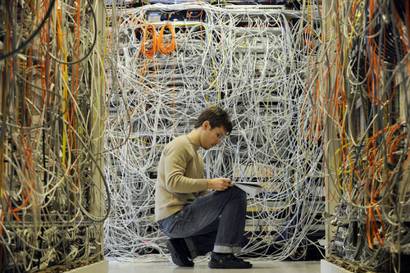
Introduction to Computer Networks (Disadvantages)
In General
Psychology (lack of direct interaction)
Personal information generally available (no more secret)
Socially (abuse, pornography, bullying, fraud)
Cyberterorism, Cyberwar (please watch Die Hard 4 or The Net)
Network Administrator
ERROR !!! (you’re become a fugitive, a lot of people want to KILL YOU !!!)

Slide 14
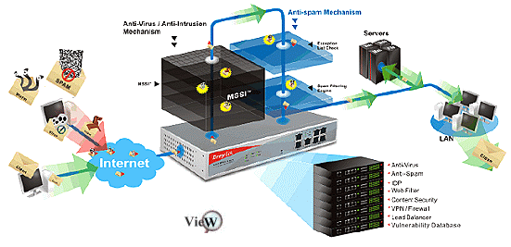
Introduction to Computer Networks (Applications)
Communication (e-mail, chat, im, voip, vicon)
Resource Sharing (hardware and software)
Information Sharing (files, databases)
Cloud Computing (Offices, Bussiness)
Cluster Computing (Super Computer)
GRID Computing (Distributed processing)
SAN (Storage Management)
What do you need ? (Multimedia, Databases, Security, Appliance, etc)

Slide 15
Introduction to Computer Networks (Applications – Further More)
HCI (Hyper Convergence Infrastructure)
SDN (Software Defined Network)
ML-Based (Machine Learning)
IoT (Internet of Thing)
Blockchain (CryptoCurrency)
Security, Network Management, Infrastructure, etc.
What do you think ? (Let’s get crazy on everything, Think outside the box)

Slide 16
Any Question ?
Anything to discuss ?

